Slide 1
Northwind Traders
Exploratory Data Analysis (EDA)

Slide 2
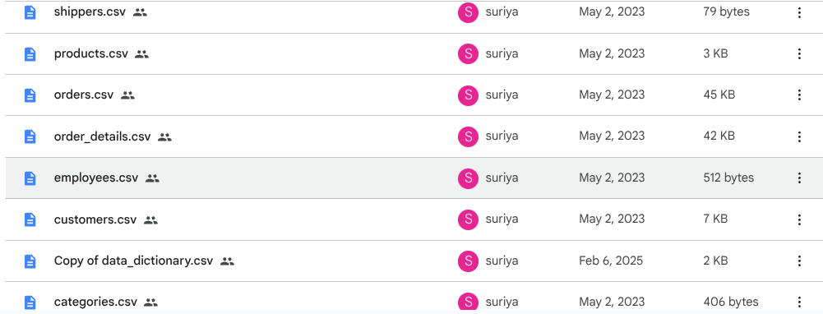
Northwind Traders Provide total of 7 CSV Files

Slide 3
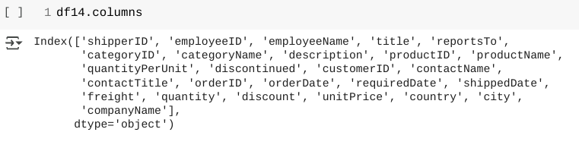
Step - 1: Merging a 7 datasets

Slide 4
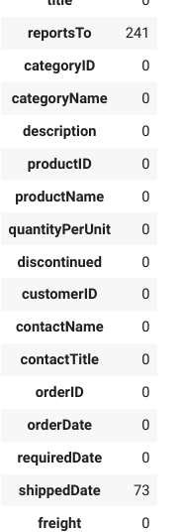
Step 2: Handling Missing Values
to fill missing value - mean, median, mode, ffill, bfill and custom fill or delete column more than 70% missing values based on client suggestion or business analytics referred by client
i am filling missing values based on skew and outliers

Slide 5
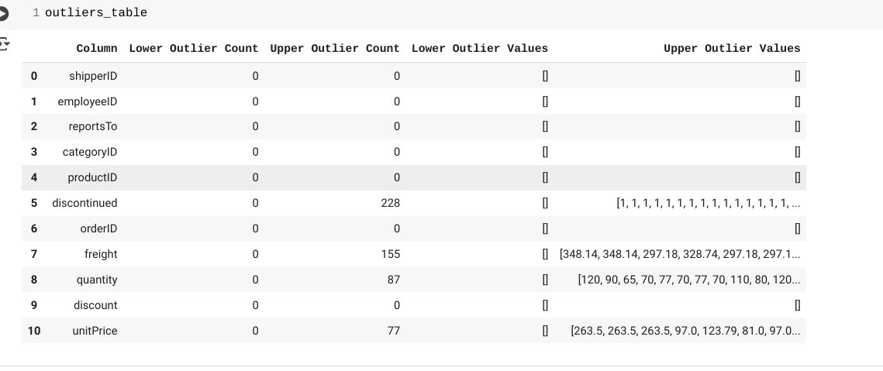
Step 3: Outliers
Find Outlier using BoxPlot & IQR Method

Slide 6
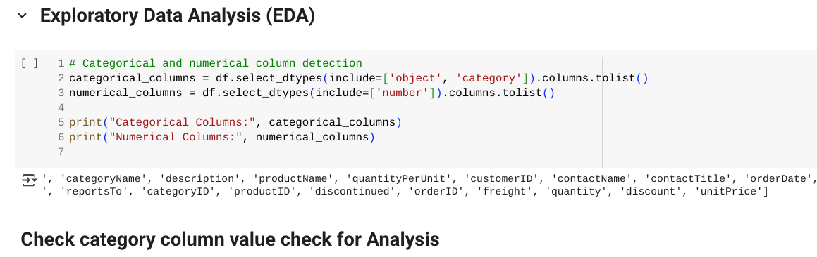
Step 4: EDA ( Exploratory Data Analysis )
Differentiate Categorical and Numerical Columns

Slide 7
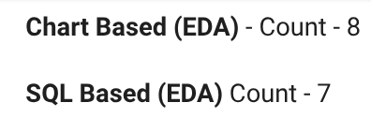
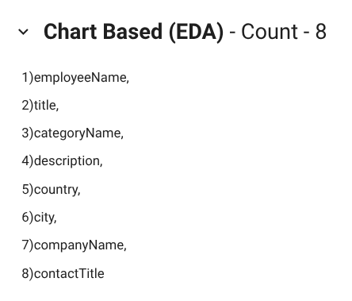
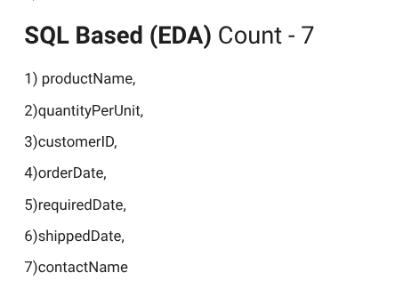
Columns have more 10 unique values i categorise as SQL Based EDA
Columns have less than 10 unique Values categorised as Chart Based EDA

Slide 8
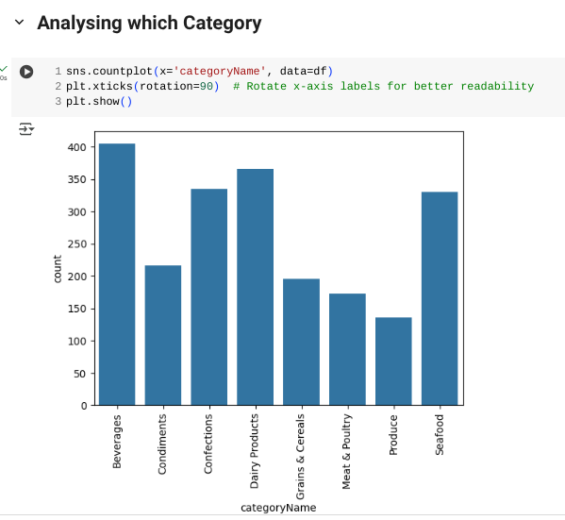
Univariate Analysis

Slide 9
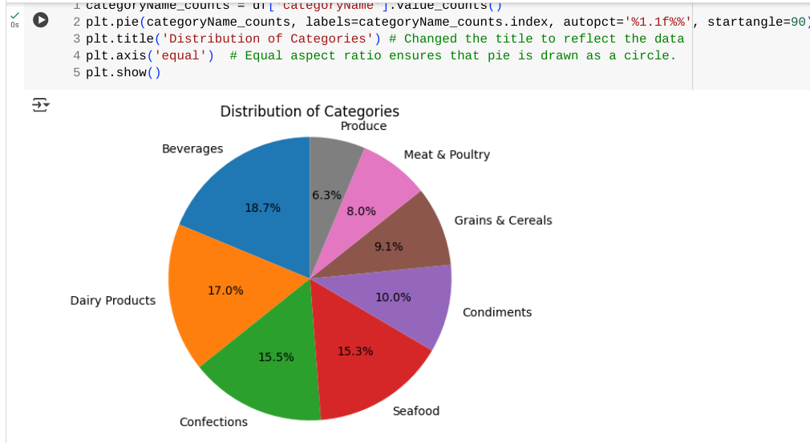

Slide 10


Slide 11
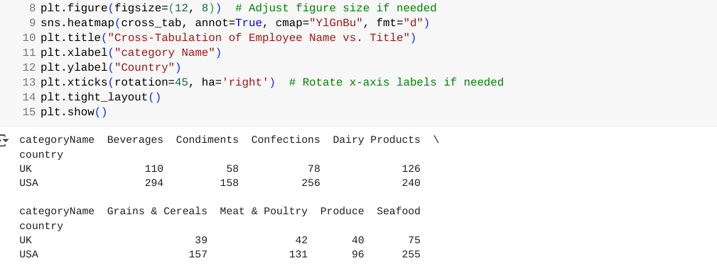
2) Bivariate Analysis

Slide 12
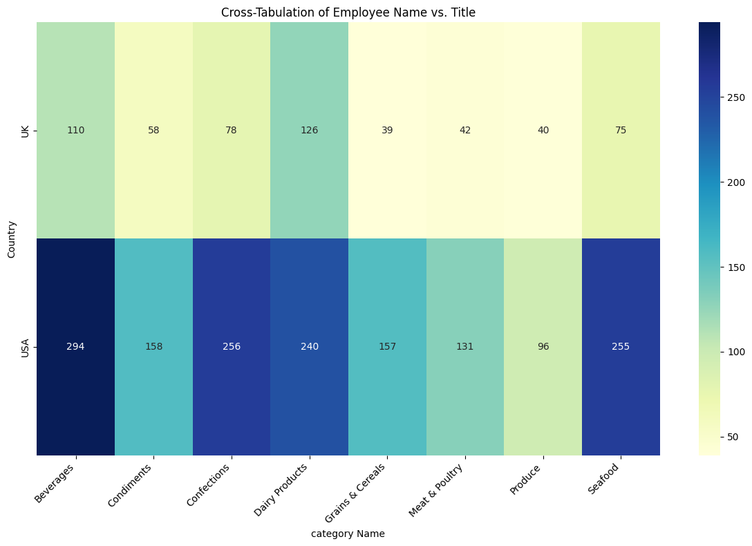

Slide 13
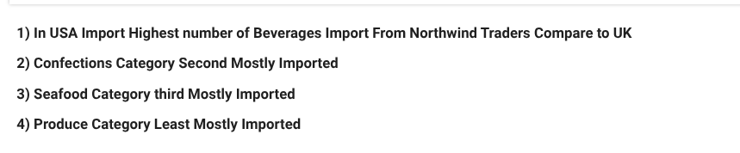
Insights

Slide 14
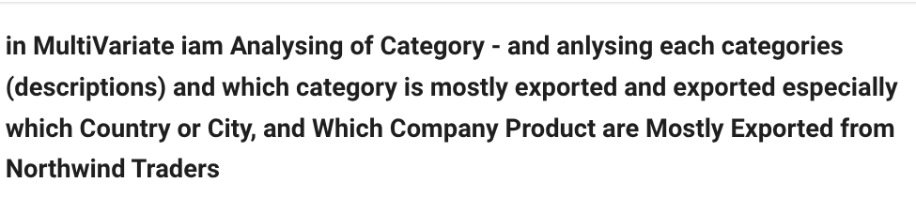
3) MultiVariate

Slide 15
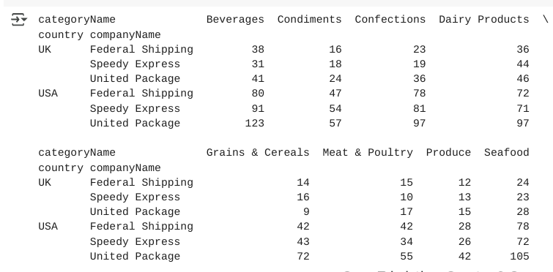

Slide 16
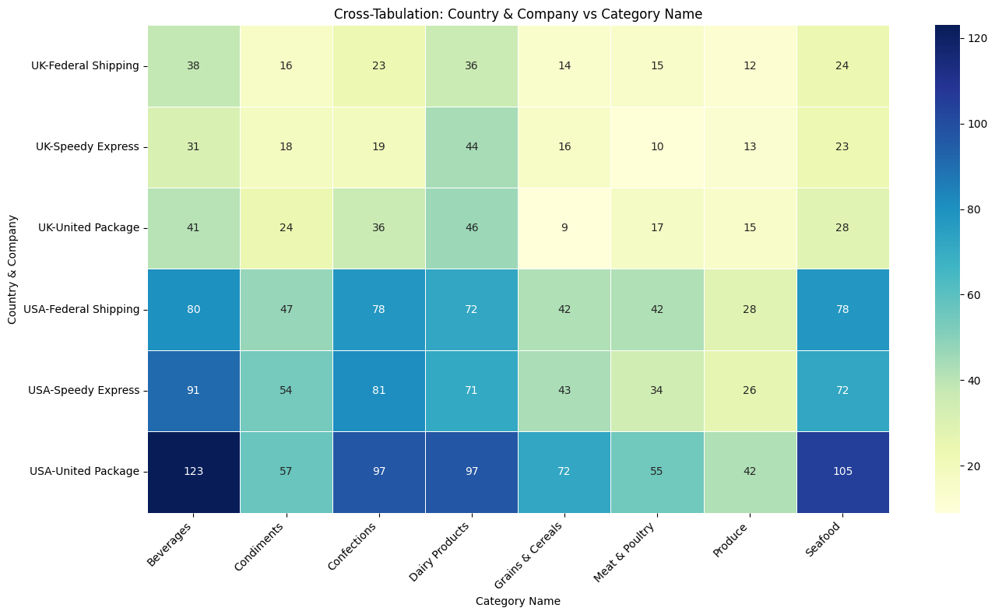

Slide 17


Slide 18
Conclusion:
Northwind Traders Export - USA & UK and New york From USA and
London From UK
Especially USA is the Largest Importer from Northwind Traders
Northwind Traders Flagship Category was Beverage items, Confections and Seafoods
United Package From USA Largest Shipping Partner for Northwind Traders they highly shipped Beverages & Seafoods
Margaret Peacock - Sales Representative Cover highest number of orders

Slide 19
Thank You

Slide 20


1. Intro
Choose one approach to grab the audience’s attention right from the start: unexpected, emotional, or simple.
Unexpected Highlight what’s new, unusual, or surprising.
Emotional Give people a reason to care.
Simple Provide a simple unifying message for what is to come

